Slide 1
Solution
Design for Governance

Slide 2



Design for Governance
Tenant Root Group
Apparel
Product Development
Marketing
Sporting Goods
Product Development
Tailwinds
Sales
Marketing
Sales

Slide 3







Design for Governance
Tenant Root Group
Apparel
Product Development
Marketing
Sporting Goods
Product Development
Tailwinds
Sales
Marketing
Sales

Slide 4
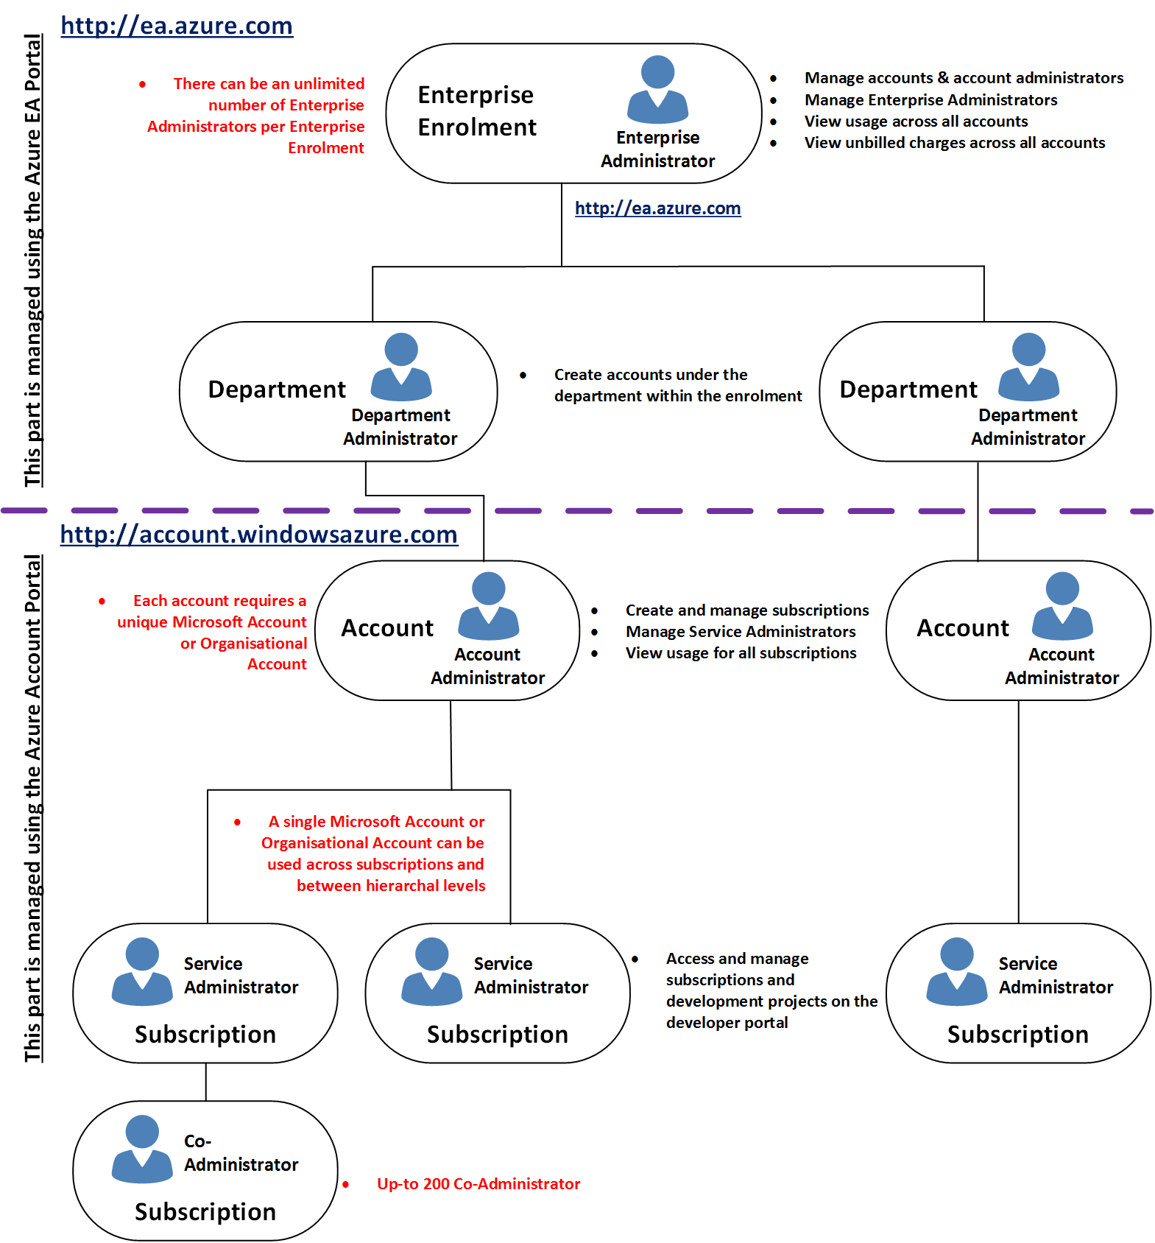





Slide 5
New Development Project
Azure Tagging for Cost
Azure Policy for VM

Slide 6
Creating Management Groups
Design with governance in mind
Hierarchy reasonably flat
Consider top-level management group

Slide 7
Key Considerations - Subscriptions
Democratized unit of management
Group them under management group
Dedicated shared service subscription
Consider making subscription owners aware for their roles and responsibilities

Slide 8
Key Considerations – Resource Group
Consider group by type
Consider group by app
Consider resource life cycle
Consider administration overhead

Slide 9
Key Considerations - Tagging
Consider your organizations taxonomy
Consider whether you need IT-aligned or business-aligned tagging

Slide 10
Key Considerations – Role Based Access Control
Remember RBAC is allow model
Assign at the highest scope level that meets the requirement
Only grant users the access they need
Assign role to groups

